Slide 1

Build a Personalized Online Course Recommender System with Machine Learning
Carlo Contaldi
15/04/2026

Slide 2

Outline
Introduction and Background
Exploratory Data Analysis
Content-based Recommender System using Unsupervised Learning
Collaborative-filtering based Recommender System using Supervised learning
Conclusion
Appendix

Slide 3
Introduction
Online learning platforms such as Coursera offer a plethora of courses
Virtually over any branch of knowledge
Useful for any kind of job/activity
World-class learning for individuals and organizations
Challenge – Recommend the most adequate courses to millions of learners
Based on their goals, aspirations, interests, areas of improvement
This project offers Machine Learning solutions for a Personalized Online Course Recommender System
Unsupervised methods – User Profile-based, Course Similarity-based, Clustering-based
Supervised methods – KNN, NMF, NN Embeddings

Slide 4
Exploratory Data Analysis

Slide 5
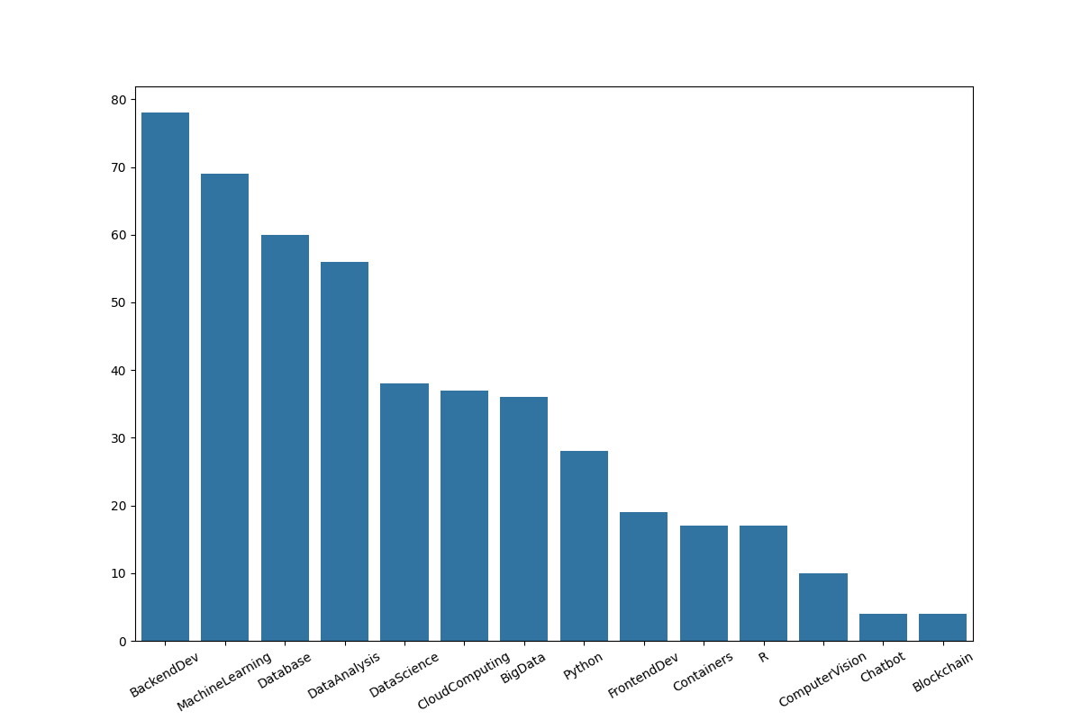
Course counts per genre
Notes:
Histogram showing course counts per genre, with top one (BackendDev) characterized by ~80 courses. It's an expectedly unbalanced distribution.

Slide 6
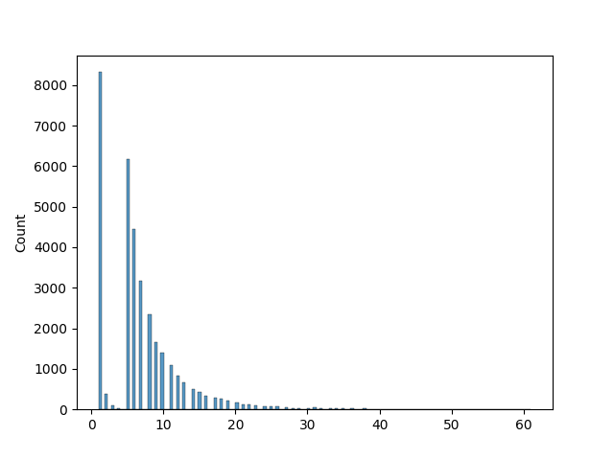
Course enrollment distribution
Notes:
How many users (y axis) enrolled in how many courses (x axis). We can notice how it's most common to be enrolled in a single course, but the next most frequent occurrences are with 5, 6, 7, 8 courses, and so on. Unexpectedly fewer users enrolled in just 2, 3 or 4 courses.

Slide 7
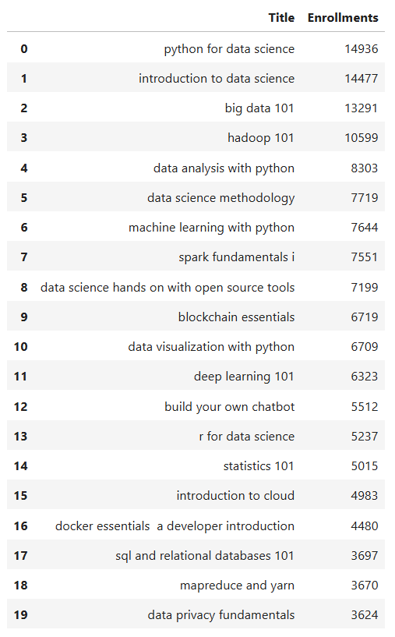
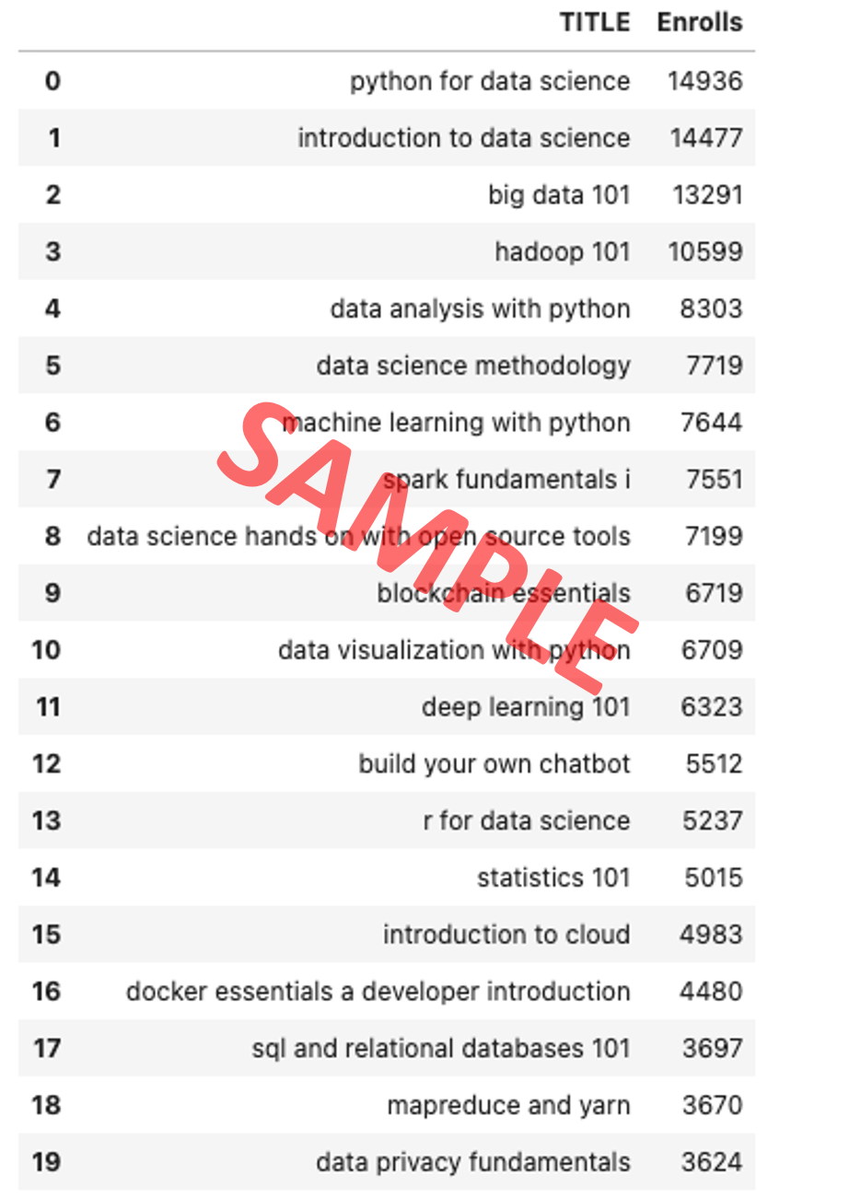
20 most popular courses
Notes:
DataFrame showing top 20 courses in terms of popularity (enrollments)

Slide 8
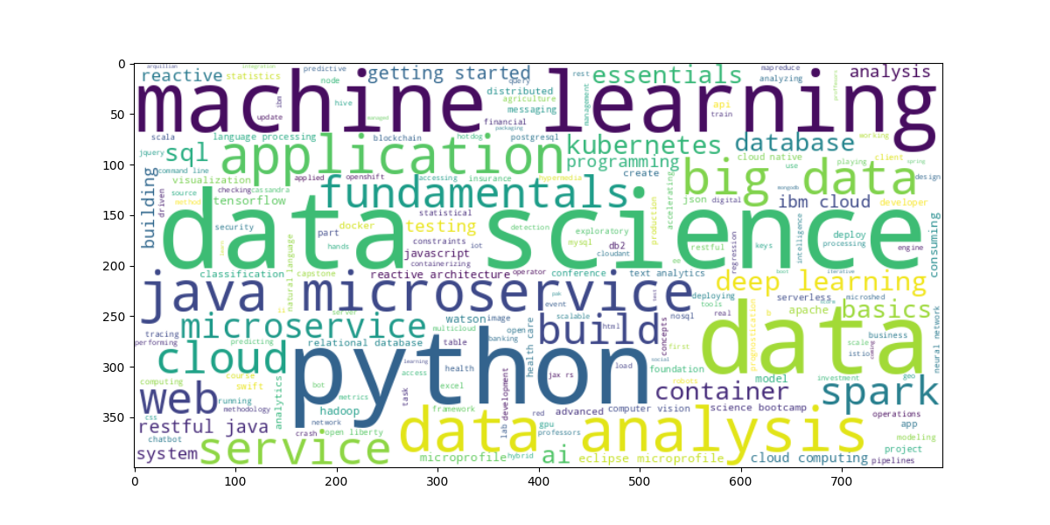
Word cloud of course titles
Notes:
word cloud of course titles, showing most frequent terms in all courses' text (titles and descriptions)

Slide 9
Content-based Recommender System using Unsupervised Learning
Cluster2
Cluster1

Slide 10
Flowchart of content-based recommender system using user profile and course genres
Courses User enrolled in
User Profile vector
Recommendation Matrix
-
Courses unknown by user
shown as
Recommended or
Not Recommended
User Profile
Dot Product
Threshold
Check
Course
Genre
vector
Notes:
1 get user profile vector – user ratings for each item
2 get course genre vector – genres characterizing each item
3 multiply user ratings by genres matrix to get weighted genre matrix; sum across genres and normalize to get user profile
4 multiply user profile by unknown items matrix to get weighted items matrix; sum over items to get recommendation matrix

Slide 11
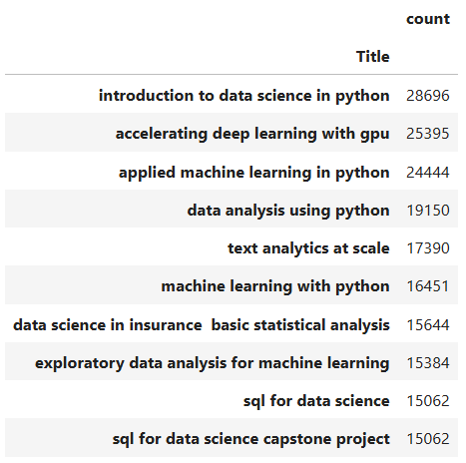
Evaluation results of user profile-based recommender system
Top-10 recommendations​
Threshold = 10

Slide 12
Flowchart of content-based recommender system using course similarity
All Courses
Recommendation Matrix
-
Courses unknown by user
shown as
Recommended or
Not Recommended
Courses Unknown
by User
Course Similarity Matrix
Difference
Threshold
Check
Courses User enrolled in
Notes:
1 get items unknown by user
2 get similarity matrix among all items based on BoW or other similarity techniques
3 get items unknown to user which are similar to enrolled ones based on similarity matrix
4 apply threshold to get recommendation matrix

Slide 13
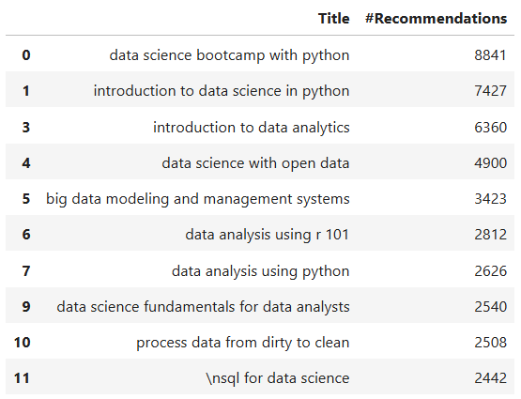
Evaluation results of course similarity-based recommender system
Top-10 recommendations​
Threshold = 0.5

Slide 14
Flowchart of clustering-based recommender system
User Profile Matrix
Scaler
Identify #clusters
(e.g. Elbow method)
Apply Clustering
Users assigned to Clusters
Find top items
from target User's Cluster
Target User
Recommended Courses
Notes:
1 get user profile vectors
2 scale data
3 identify adequate #clusters, e.g. with elbow method
4 cluster users
5 get target user's cluster and find top items from users in the cluster

Slide 15
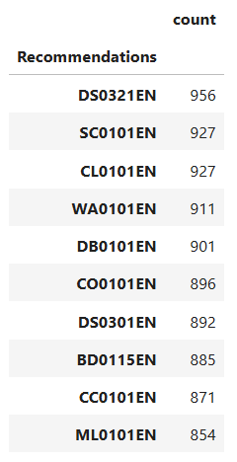
Evaluation results of clustering-based recommender system
Top-10 recommendations​
with PCA + K-Means
Threshold = 100

Slide 16
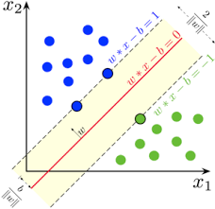
Collaborative-filtering Recommender System using Supervised Learning

Slide 17
Flowchart of KNN-based recommender system
Active User Course Enrollments
Recommendation
Matrix
Weighted Ratings
Matrix
Dot Product
KNN
Similarity Matrix
All Users
Course Enrollments
Notes:
1 learn similarity weights between active user and a selection of the other users
items seen by active user are taken into account
can be done in many ways
euclidean distance
pearson's correlation
cosine similarity
selection is by the k nearest neighbors
2 get Weighted Ratings Matrix by multiplying Ratings Matrix by Similarity Matrix
3 get Recommendation Matrix by summing Weighted Ratings for each item, and then by dividing the result by the sum of the involved similarities (weights)

Slide 18
Flowchart of NMF based recommender system
User Latent Matrix
Sparse User-Item
Interaction Matrix
(incomplete)
Sparse User-Item
Interaction Matrix
(complete)
NMF
Dot Product
Item Latent Matrix
Notes:
1 get the sparse user-item interaction matrix (incomplete)
2 decompose the matrix into user matrix and item matrix with latent features via NMF
3 it's possible to get any recommendation estimate for user i and item j via the dot product of related vectors in latent matrices

Slide 19
Flowchart of Neural Network Embedding based recommender system
User One-Hot Vector
User Embedding
Layer
User Feature Matrix
Sparse User-Item
Interaction Matrix
(incomplete)
Sparse User-Item
Interaction Matrix
(complete)
Dot Product
Item One-Hot Vector
Item Embedding
Layer
Item Feature Matrix
Notes:
allows to predict ratings without building explicit feature vectors
like NMF, NNs can be used to extract latent user and item features
can predict course ratings while simultaneously extracting users' and items' latent features
1 get user/item rating dataset
2 define one-hot vectors for users and items
3 define user and item embedding layers taking as input such vectors
these layers learn latent features
4 they output the embedding feature vectors
5 dot product such vectors to get rating estimation

Slide 20
Compare the performance of collaborative-filtering models
Notes:
KNN- and NMF-based recommender systems yielded similar performances, with an RMSE ~ 1.3. We can observe a substantial improvement with NN-based methods, yielding RMSE values around 0.445. Best NN hyperparameter configuration was observed by considering an embedding size of 16 and a Ridge Alpha value of 1e-5.

Slide 21
Conclusions
Clustering-based methods allow higher flexibility for an unsupervised recommender system
Variety of results depending on chosen clustering method, #clusters, threshold, etc.
Content-based unsupervised recommender systems follow more of a deterministic approach
User profile-based system yielded a considerably higher #recommendations per user (20-60) compared with Course similarity-based system (1-3)
This generally happens because similarities among users are more frequent than those among items, also due to their relative amounts
On the other hand the User Profile-based method doesn't allow to recommend items of new genres to the target user
NN Embedding-based resulted as the best-performing supervised recommender system
Overcome problems of data sparsity, cold start and scalability of standard collaborative filtering methods
But requires a large training dataset as well as careful hyperparameter tuning and regularization
As part of future developments it's possible to investigate Regression-/Classification-based Recommenders integrating NN Embeddings as input features

Slide 22
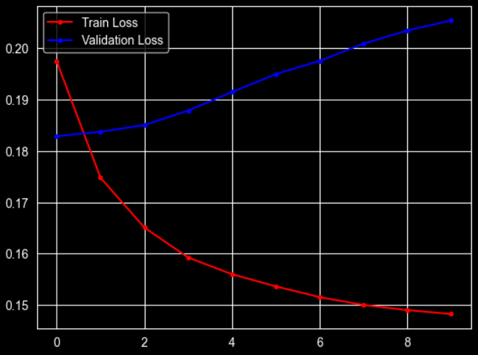
Appendix
Best-performing model code & run history
embedding_size = 16
ridge_alpha = 1e-5
model = RecommenderNet(
num_users, num_items, embedding_size, ridge_alpha
)
model.compile(
optimizer=keras.optimizers.Adam(),
loss=keras.losses.MeanSquaredError(),
metrics=[tf.keras.metrics.RootMeanSquaredError()],
)
run_hist = model.fit(x_train, y_train, validation_data=(x_val, y_val), epochs=10, batch_size=64)
saved_model = model.save_weights('recommender_net_weights.weights.h5')
fig, ax = plt.subplots()
ax.plot(run_hist.history['loss'],'r', marker='.', label='Train Loss')
ax.plot(run_hist.history['val_loss'], 'b', marker='.', label='Validation Loss')
ax.legend()
Notes:
Based on validation loss trend we can conclude that the model could appreciate further regularization to avoid overfitting and achieve more performing results

